Slide 1


ARVIO ANANDI
BANK CUSTOMER CHURN PREDICTION

Slide 2


TABLE OF CONTENTS
Business Background
Data Understanding
Data Wrangling & EDA
Data Preprocessing
Data Visualization
Modeling & Evaluation
Business Case Study
Conclusion & Recommendations

Slide 3
BUSINESS
BACKGROUND

Slide 4
BUSINESS BACKGROUND
As a data scientist freelancer collaborating with a prominent bank in the EU, my mission revolves around predicting customers who are likely to churn. The bank entrusted me with the task of leveraging advanced analytics to identify this specific group. By doing so, the bank can precisely target this smaller audience group for marketing efforts, leading to significant savings in costs and time. This strategic approach does not only optimize resources but also ensures a focused and effective retention strategy, enhancing both customer satisfaction and the bank's overall efficiency.

Slide 5
BUSINESS OBJECTIVES
The primary business objective is to develop a highly accurate customer churn prediction model. This model will enable the bank to identify customers at risk of leaving, allowing for more actionable efforts to be made. By minimizing churn through strategic retention initiatives, the bank aims to enhance customer loyalty, optimize marketing costs, and improve overall customer satisfaction. Additionally, the project seeks to establish a data-driven culture within the bank, fostering innovation and ensuring long-term competitiveness in the financial market.

Slide 6

OUTPUT
The output of this project is a model to predict the customers who are at risk of leaving the bank given its features.
The features include Age, CreditScore, EstimatedSalary, etc.

Slide 7
DATA UNDERSTANDING

Slide 8

DATA SOURCE
The dataset was acquired from Kaggle, with 10000 rows and 18 columns.

Slide 9
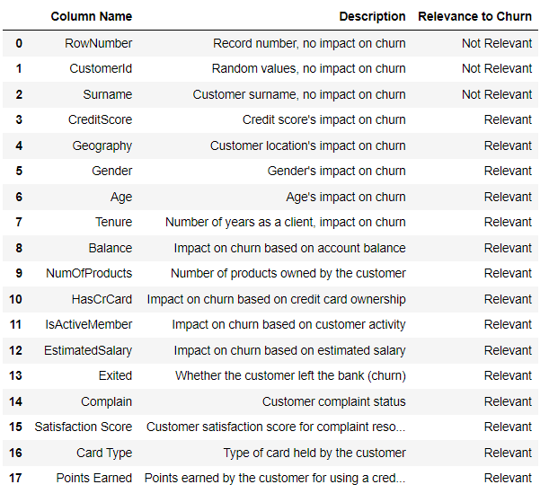
COLUMN EXPLANATION

Slide 10


ANALYTIC APPROACH
Supervised Learning (Binary Classification)
To classify customers into groups of churned and not churned.
Metrics
AUC_ROC, Precision, F1, Recall, and Accuracy as support for our prediction

Slide 11
DATA SPLIT RATIO
We split the data into the ratio of 80:20, where 80% is for training and 20% for testing and evaluating the model.

Slide 12
DATA WRANGLING

Slide 13

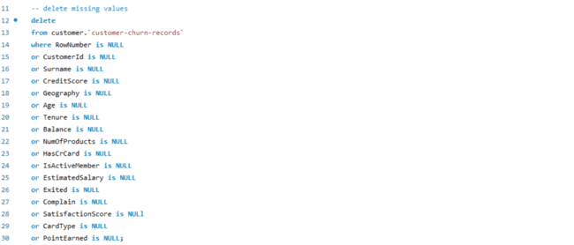
Removed missing values

Slide 14
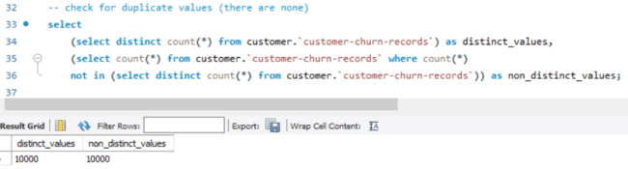
There seems to be no duplicates as the distinct values and non distinct value comparison is the same

Slide 15
EXPLORATORY DATA ANALYSIS
(SQL)

Slide 16
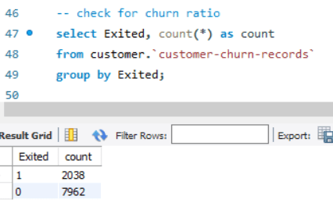
This table shows that there seems to be data imbalance for churned and not churned customers. This explains that roughly 80% of customers decided not to churn from the bank.

Slide 17
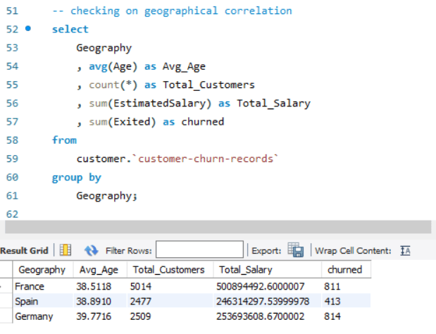
The table shows the distribution of churned customers from different countries. This tells us that people from France and Germany are more likely to churn than people from Spain.

Slide 18
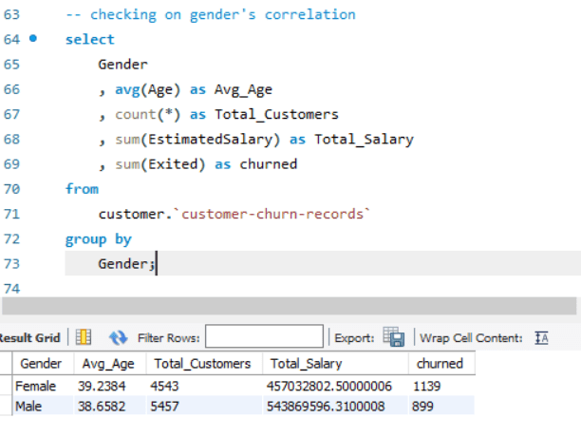
From the given dataset, female customers tend to churn more than male customers. This could provide some insights and be explored further.

Slide 19
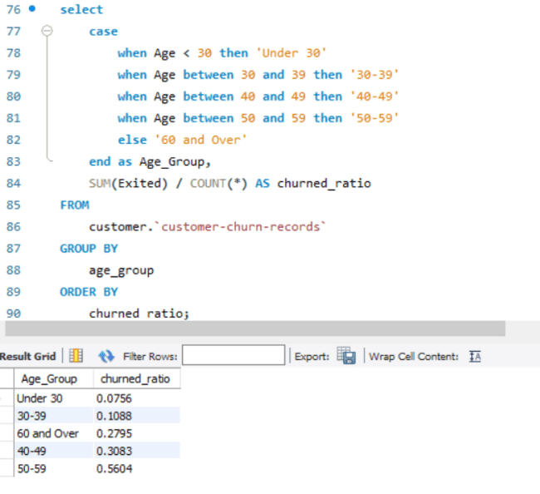
People under 39 and over 60 years of age have a fair share of not churning from the bank. For the young group, this could be explained by their digitalized environment where information are easily consumed which explains their financial literacy that helps to determine their long-term bank decisions whereas for the seniors, this could be explained by a more stable financial decisions, and their long-term relationships with banks which corresponds to them not switching banks

Slide 20
For a better grasp of exploration and understanding of underlying features , we perform Exploratory Data Analysis in python.

Slide 21
EXPLORATORY DATA ANALYSIS
(PYTHON)

Slide 22
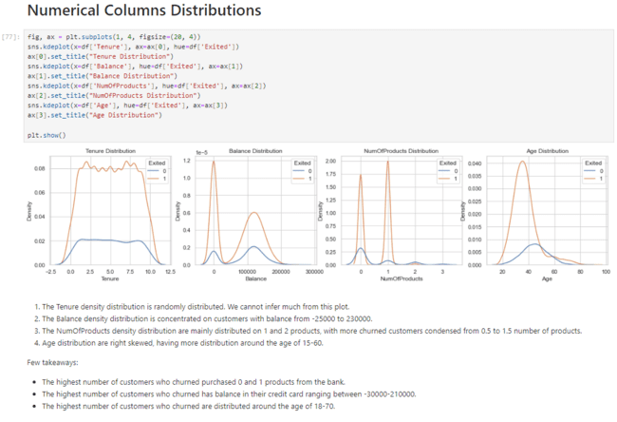

Slide 23
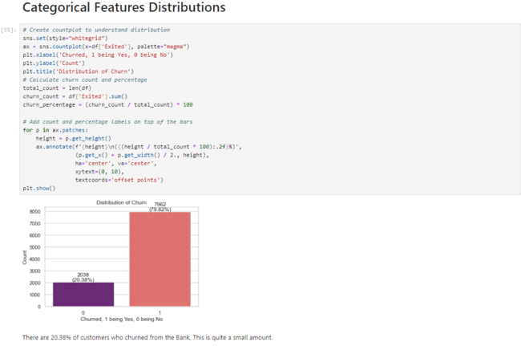

Slide 24
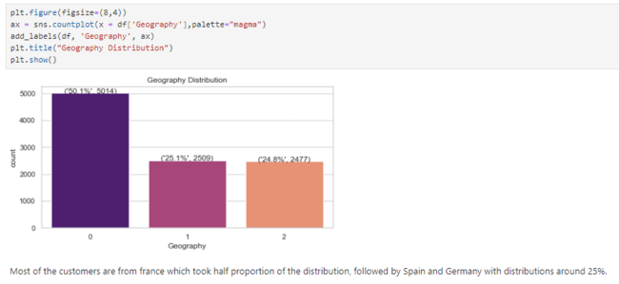

Slide 25
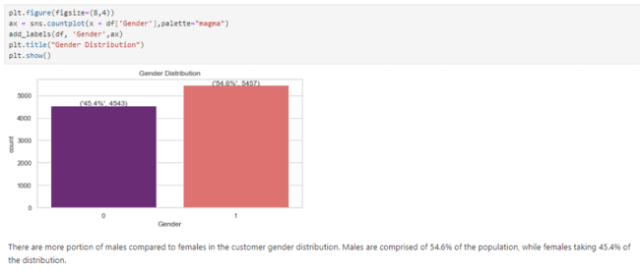

Slide 26
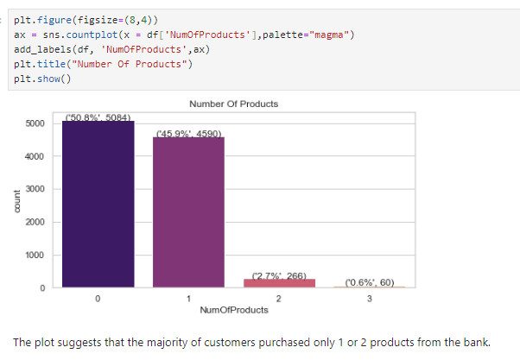

Slide 27
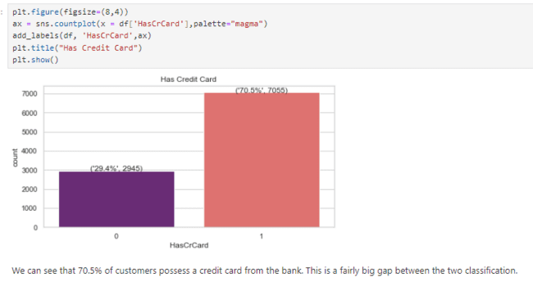

Slide 28
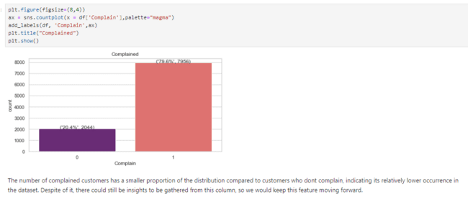

Slide 29
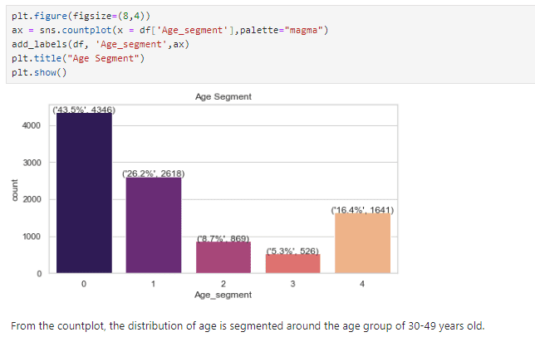

Slide 30
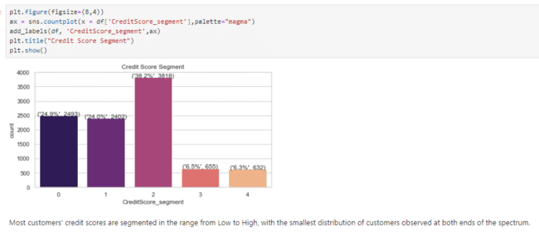

Slide 31
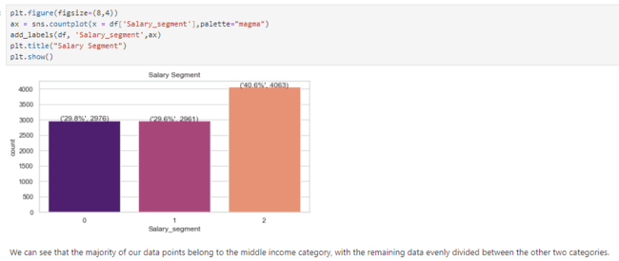

Slide 32
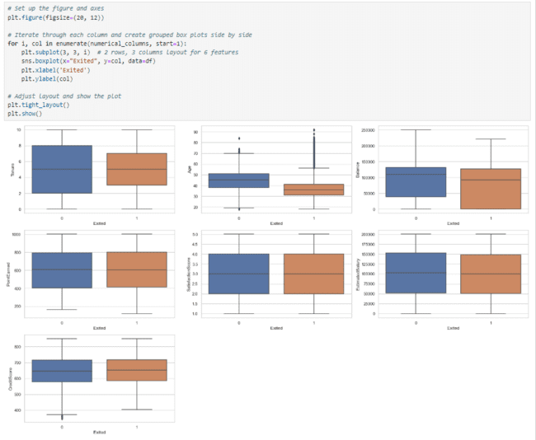

Slide 33
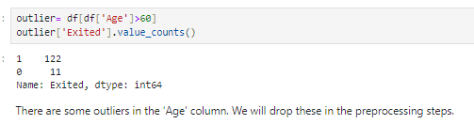

Slide 34
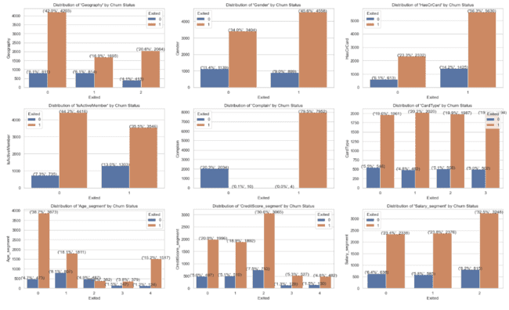

Slide 35
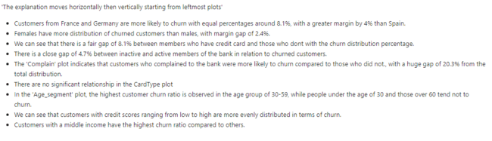

Slide 36
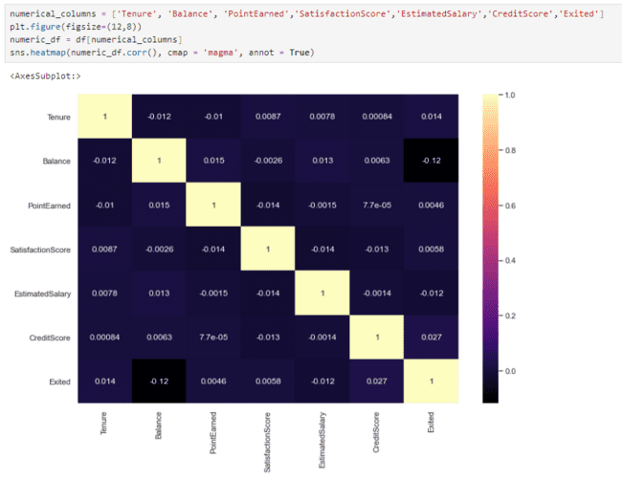

Slide 37
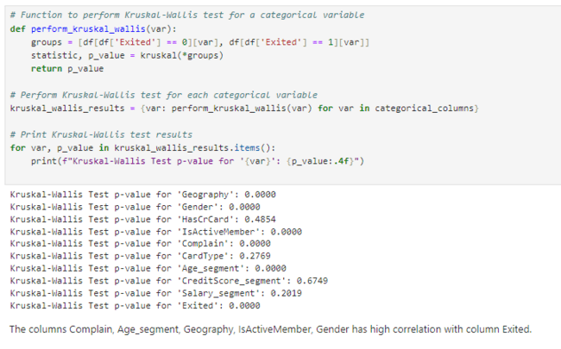

Slide 38
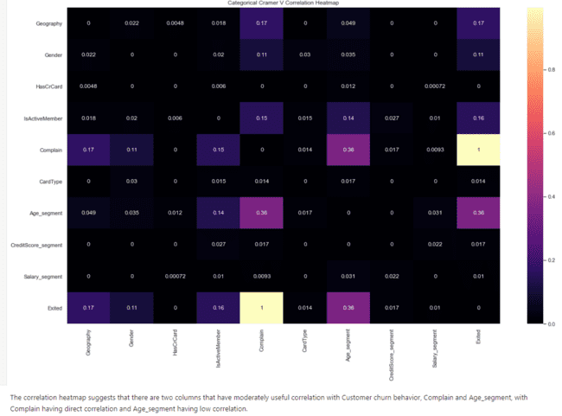

Slide 39
DATA PREPROCESSING

Slide 40
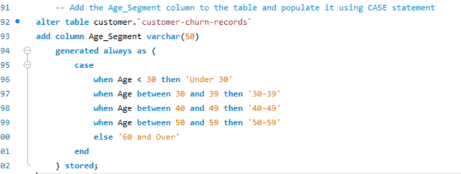
Feature engineer a new feature called Age_segment to segment the age groups to 5 groups (Under 30, 30-39, 40-49, 50-59, and 60 and Over).

Slide 41
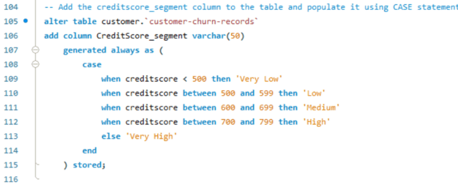
Feature engineer a new feature called Creditscore_segment to segment the CreditScore to group of 5 categories (Very Low, Low, Medium, High, and Very High).

Slide 42
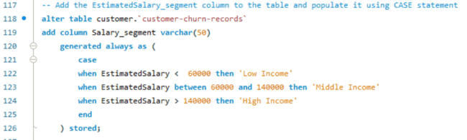
Feature engineered a new feature called Salary_segment to segment the Salary to groups of 3 categories (Low Income, Middle Income, and High Income).

Slide 43
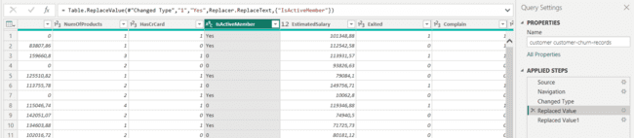
In Power BI, using the Power Query Transform, i changed the values of column IsActiveMember from 1 and 0s to Yes and No. This was done to create clearer labels for visualization later.

Slide 44
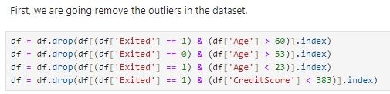

Slide 45
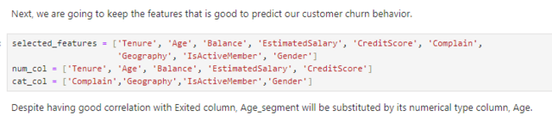

Slide 46
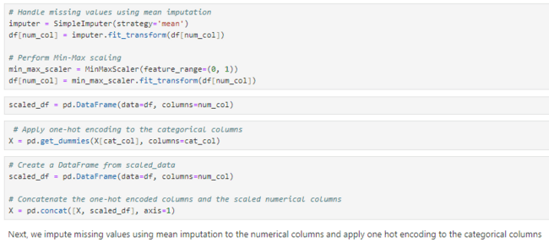

Slide 49
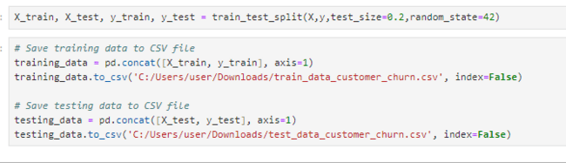
Then, we split the data to 80 and 20 ratio, and export to separate csv files.

Slide 50
DATA VISUALIZATION

Slide 51
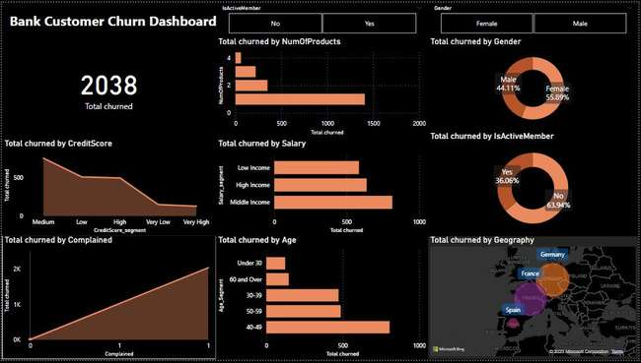

This dashboard was created using Microsoft Power BI and Power Query Transform. Feel free to slice the data using the slicers provided. The purpose of the two slicers were to avoid visualization misunderstandings.

Slide 52
KEY FINDINGS & INSIGHTS

Slide 53
Customers with very high and very low credit score tend not to churn.
Customers who rarely complain about bank products tend not to churn.
Customers who subscribes to more bank products tend not to churn.
Customers with Low and High Income tend not to churn.
The youngest and oldest group of customers tend not to churn.
Males are less likely to churn than females.
Active members are less likely to churn than non-active members.
Customers from Spain are less likely to churn than customers from Germany or France.

Slide 54
MODELING & EVALUATION

Slide 55
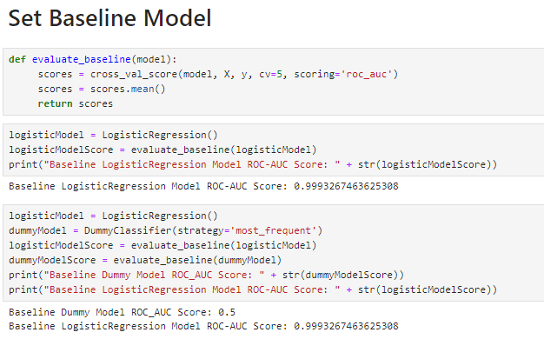
First step, we set a baseline model as comparison for our better model. The ROC_AUC score predicts with 0.99 score.

Slide 56
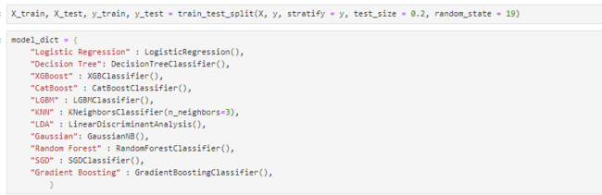
Next, we split the training data, and prepare the model list that we are going to fit to our train data.

Slide 57
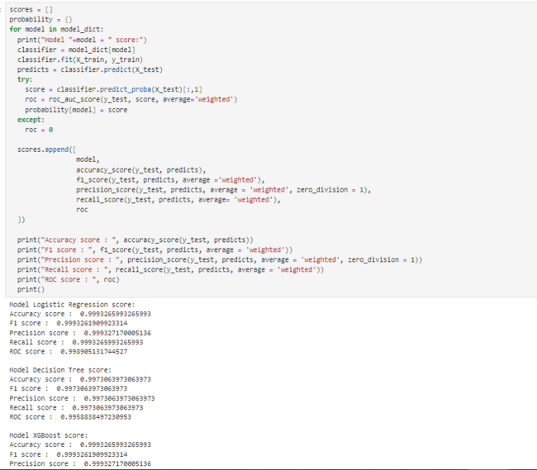
Then, we are going to fit each models and calculate the metrics.

Slide 58
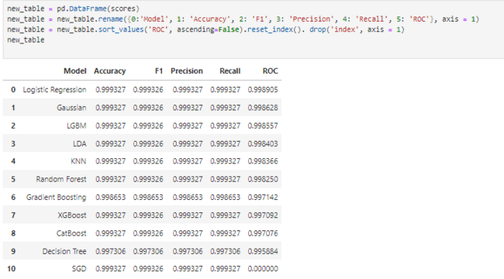
We can see that the highest ROC score is achieved by the Logistic Regression model. We will continue with this model.

Slide 59
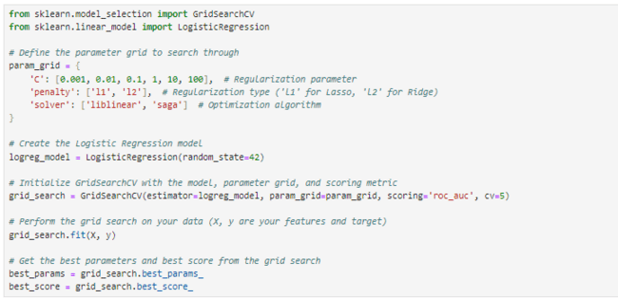
Next, we would tune the parameters using gridSearch method to gain better hyperparameters in order to achieve better ROC score from our model.

Slide 60
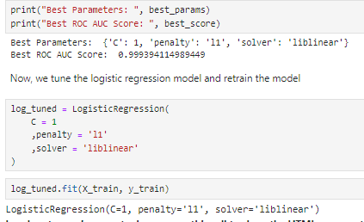
We then set the new parameters to our previous model and fit it again to the training data.

Slide 61
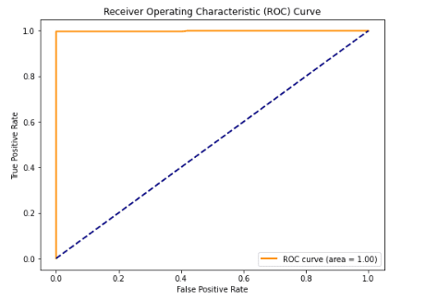
We achieved a high ROC curve.

Slide 62
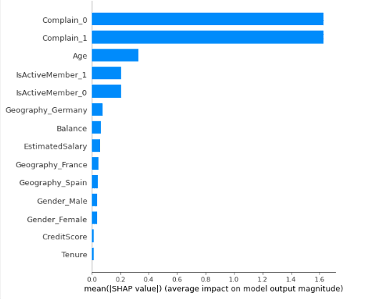
From the shap plot, the most impact came from Complain, Age, and IsActiveMember features.

Slide 63
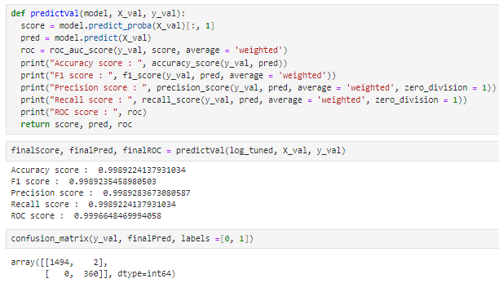
We go on with predicting the final data using the model we tuned.

Slide 64
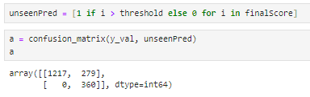
Then, we predict the unseen data using the tuned logistic regression model we had.

Slide 65
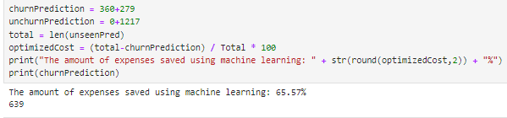

Slide 66
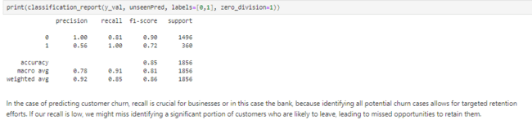

Slide 67
BUSINESS CASE STUDY

Slide 68
By using the model prediction output to as guidance to reach out customers, the Bank could save up to 65.57% in expenses (Marketing efforts, time costs, operational costs, etc.)

Slide 69
CONCLUSION & RECOMMENDATIONS

Slide 70
CONCLUSION
Supervised Machine Learning has been proven to be able to predict the customer ' s churn response with 1.00 roc_auc score and recall score. It also helps the company to reduce expenses up to 66% from reaching out customers.

Slide 71
RECOMMENDATIONS
1. Tailored Loyalty Programs: Develop personalized loyalty programs based on customer segments. Offer incentives and rewards to high-churn-risk groups to encourage their loyalty.
2. Improved Customer Service: Enhance customer service, especially for customers who frequently complain. Swift and effective complaint resolution can significantly improve customer satisfaction and retention rates.
3. Product Bundling: Encourage customers to subscribe to multiple bank products by offering bundled services. Create packages that cater to various needs, providing an incentive for customers to stay.
4. Income-Adjusted Services: Customize services based on income levels. Offer financial products that align with the financial capacity of customers, ensuring affordability and value for money.
5. Age-Specific Engagement: Understand and address the unique requirements of different age groups. Develop age-specific products and services, ensuring relevance and appeal across generations.

Slide 72
RECOMMENDATIONS
6. Gender-Inclusive Services: Create banking services that address the specific needs of both genders. Recognize diverse financial goals and preferences, making the bank more inclusive.
7. Active Member Recognition: Acknowledge and reward active members. Offer exclusive services, discounts, or privileges to keep active members engaged and loyal.
8. Cultural Sensitivity: Recognize and respect cultural differences, especially for customers from different countries. Offer services that resonate with their cultural values, building trust and customer loyalt.
9. Regular Feedback Mechanism: Implement a systematic feedback system. Regularly collect feedback from customers to understand their evolving needs and concerns, allowing the bank to adapt its strategies accordingly.
10. Data-Driven Decisions: Invest in advanced analytics and AI tools to continually analyze customer behavior. Predictive models can identify potential churners early, allowing the bank to take proactive measures.

Slide 73
RECOMMENDATIONS
11. Increase data points and volume to the model to prevent underfitting and improves overall score in predicting unseen datasets.
12. Investigate the cause of complains upon the system, fixed them, iterate, and hopefully gain new insights.

Slide 74



THANK YOU
CONTACTS
+6287764260779
arvioanandi@gmail.com
PROJECT LINK
Bank Customer Churn Prediction

